Slide 1



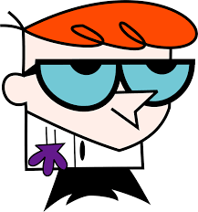

Overview of the Previous class: Encapsulation
Protected
private
base class
package
cannot access
our parents
private
cannot access each other
subclass
no-modifier
cannot access
our parents
Protected
cannot access
Other class
Public

Slide 2
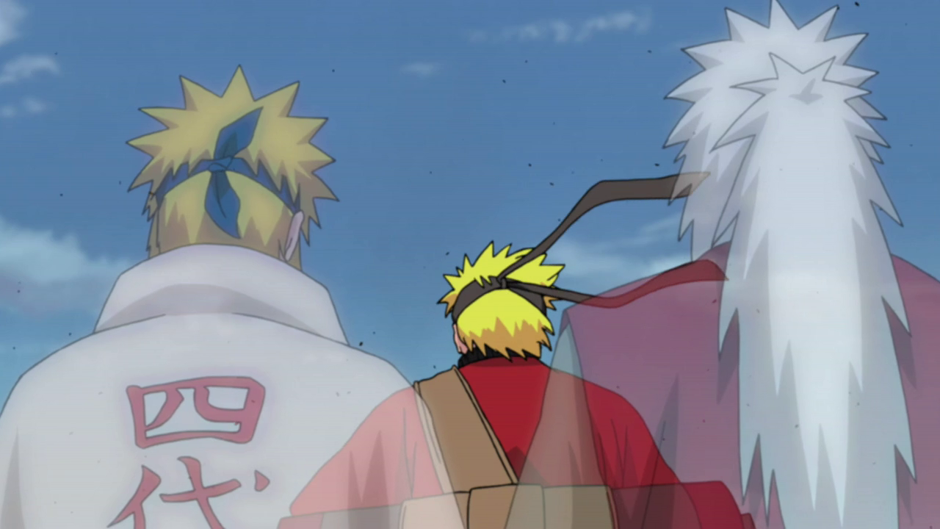


Slide 3

If you watched Naruto, then you are familiar with inheritance

Slide 4
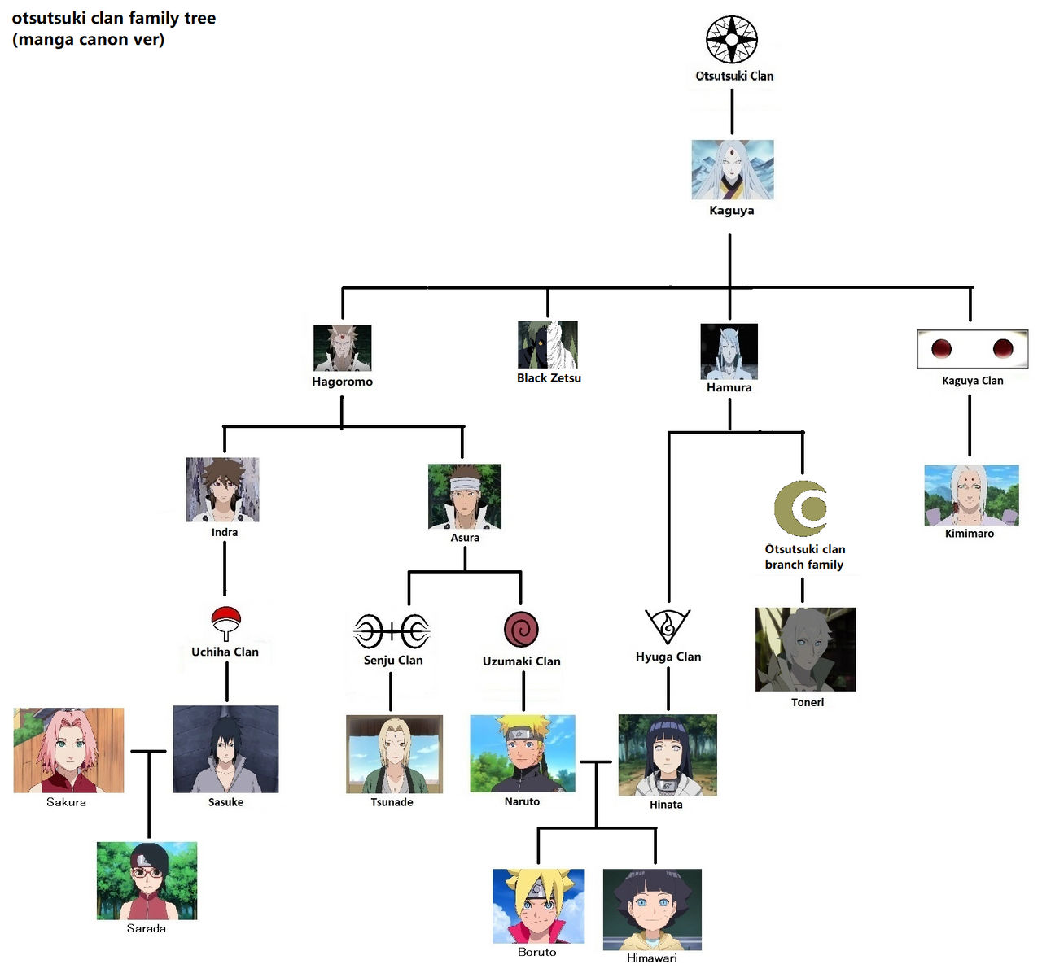
Object
io.Outputstream
awt.Component
io.ObjectOutputStream
org.omg.CORBA.portable.OutputStream
awt.canvas
awt.container
awt.button

Slide 5
I am the OBJECT
Every class is a subclass of me
Every class can have only one parent class

Slide 6
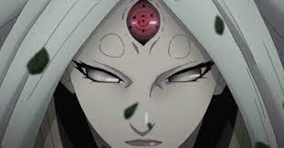
Got it?

Slide 7
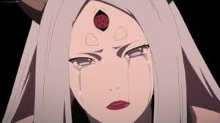
Otherwise, go through the slides again

Slide 8
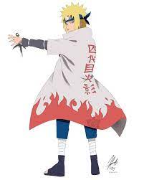


Father
Son
Father
Son
Super class
Sub class
Super class
Sub class

Slide 9
Father
Son
Father
Son
Calling father using super()
Calling grand-father using super.super()
Super class
Sub class
Super class
Sub class

Slide 10
Father
Son
Father
Son
Calling father using super()
Calling grand-father using super.super()
Why cannot I use super. super()
Super class
Sub class
Super class
Sub class

Slide 11
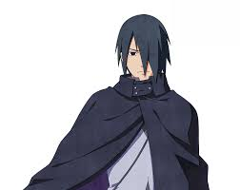
because of Encapsulation.
Child can call only immediate parent

Slide 12
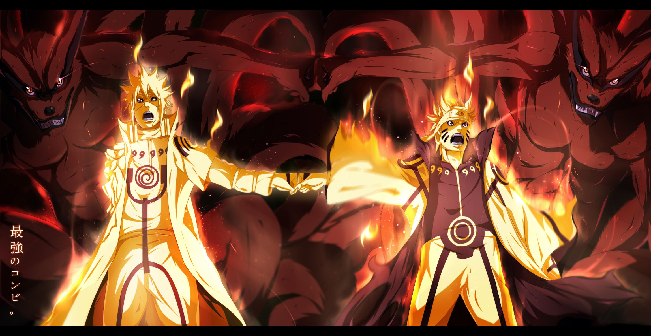
Power of inheritance is .......
Code reusability

Slide 13

public class Minato{
protected String hairColor=“yellow”;
String wife = “Kushina”;
protected String favWeapon=“Rasengan”;
protected String ability(){
return “FlyingThunderGodTechnique”;
}
}
Guess my hair color?
public class Naruto extends Minato{
}

Slide 14

Remember:
this -> a clone/object of me

Slide 15
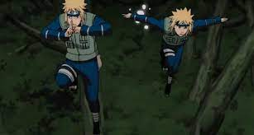
Remember:
super -> clone of the parent

Slide 16
this - current class
super – parent class
Parent
Child
this
super

Slide 17

I am Zettsu.
I am good at Casting

Slide 18

Casting: I can be anyone by touching them
Minato min = (Minato)obj;
This cast inserts a runtime check that obj is assigned a Minato clone so that compiler can safely assume that obj is a Minato.
To avoid runtime errors, use the instance of
if(obj instanceOf Minto){
Minato min = (Minato)obj;
}

Slide 19
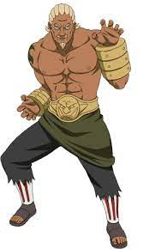
public class Minato{
protected String hairColor=“yellow”;
String wife = “Kushina”;
protected String favWeapon=“Rasengan”;
protected String ability(){
return “FlyingThunderGodTechnique”;
}
}
You have inherited ability from your father. Can you surpass him?
public class Naruto extends Minato{
}

Slide 20
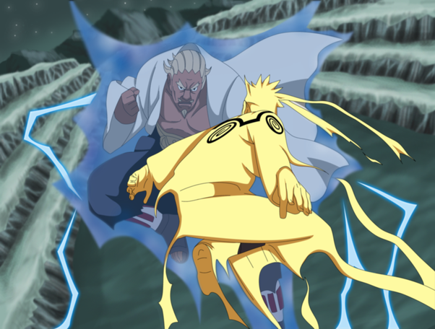
Inheritance is not enough. Can you surpass ur father?
Of course, I will surpass him using OVERLOAD

Slide 21
public class Minato{
protected String hairColor=“yellow”;
String wife = “Kushina”;
protected String favWeapon=“Rasengan”;
protected String ability(){
return “FlyingThunderGodTechnique”;
}
}
public class Naruto extends Minato{
protected String ability(){
return “FlyingThunderGodTechnique V2”;
}
}

Slide 22
Let me check

Slide 24
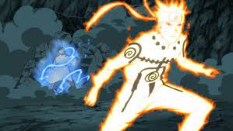
I Won

Slide 25

See you in the next class

Slide 26
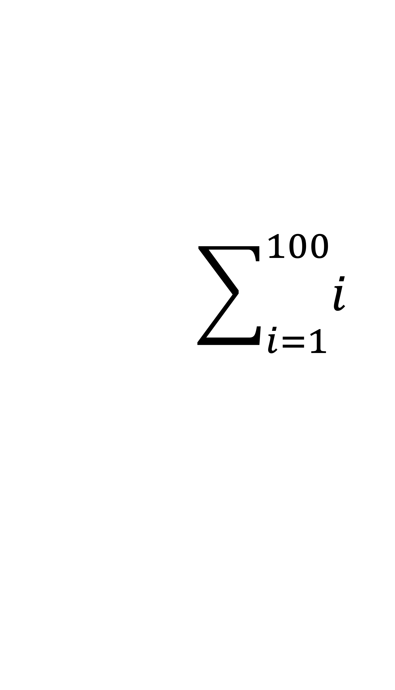
TASK 1
$$\sum_{i=1}^{100}{i}$$
1+2+3+....+100

Slide 27
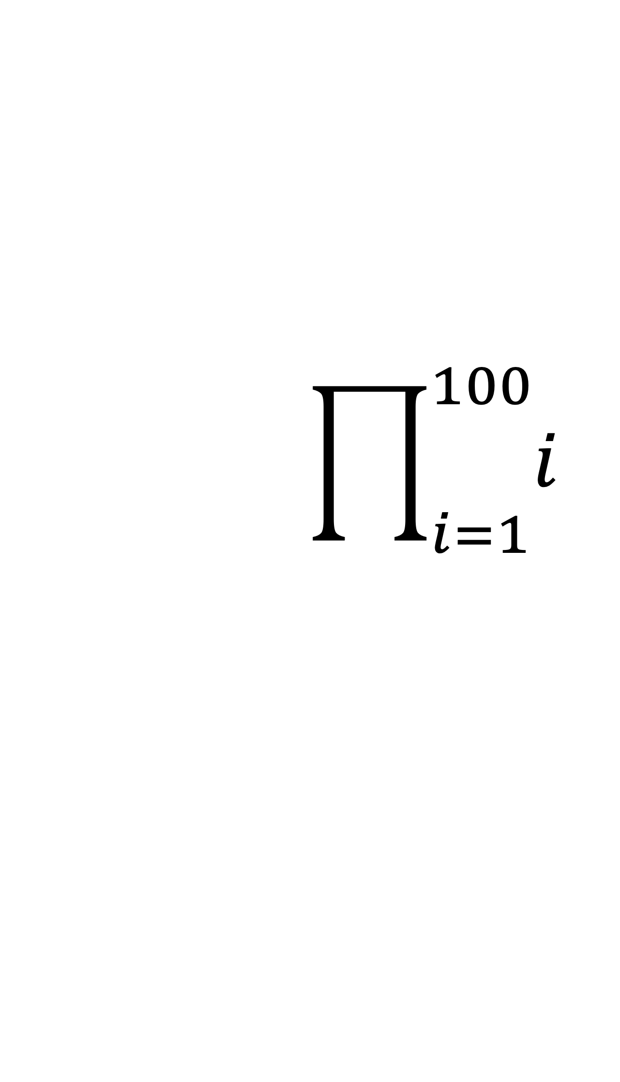
TASK 2
$$\prod_{i=1}^{100}{i}$$
1*2*3*....*100

Slide 28
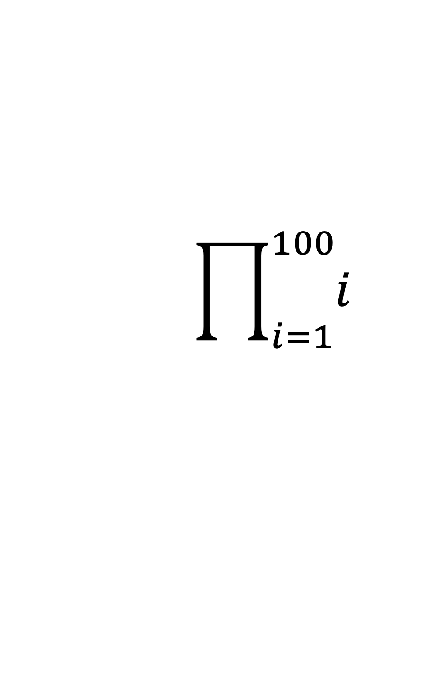
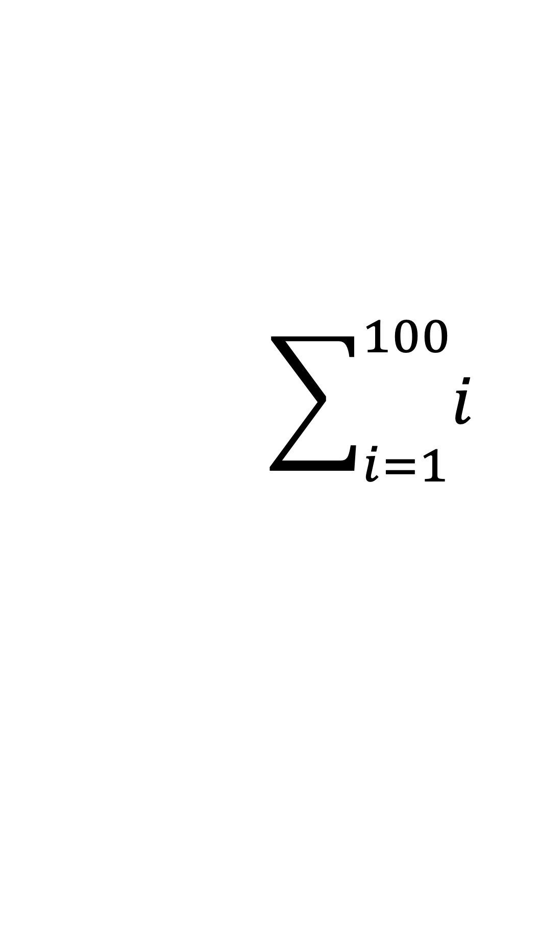
TASK 3
$$\sum_{i=1}^{100}{i}$$
$$\prod_{i=1}^{100}{i}$$
Want to be the best coder?
Hint: Using the previously written classes, try to complete this task with only one line in public static void main()

